Slide 1
ECHA Course on Artificial Intelligence for Chemical Risk Assessment Lecture 4; Foundation models Panagiotis (Panos) Karamertzanis, PhD; Michael Liem, PhD; (Marc Teunis, PhD;) Coert van Gemeren, PhD
Notes:
## Theory 1: Principles of Machine Learning
**(100 min)**
- **Principles of Machine Learning**
Machine learning involves creating algorithms that enable computers to learn from data and make predictions.
In toxicology, machine learning can be used to predict the toxicity of chemical compounds by analyzing patterns
in biological data. For example, models can be trained to identify potential carcinogens based on historical data.
- **What is AI, and which flavours? History of AI**
AI encompasses various technologies, including machine learning, that simulate human intelligence.
In chemical hazard assessment, AI can automate the analysis of large datasets to identify hazardous chemicals.
The history of AI in this field includes the development of expert systems that assist in regulatory
compliance and risk assessment.
- **Architecture - algorithm? Regression based vs neural network**
Regression models, such as logistic regression, are used to predict binary outcomes like
the presence or absence of a toxic effect. Neural networks, on the other hand, can model complex relationships
in data, such as predicting the interaction effects of multiple chemicals on human health.
- **What is a neural network, building blocks**
Neural networks consist of interconnected neurons that process data in layers. In toxicology, neural
networks can be used to model dose-response relationships, where the input layer represents chemical
concentrations and the output layer predicts biological responses.
- **Embedding; from data to numbers, examples, tensors, vectors**
Embedding techniques convert categorical data, such as chemical names, into numerical vectors that
can be processed by machine learning models. In chemical hazard assessment, embeddings can represent
molecular structures, allowing models to learn from structural similarities between compounds.
- **Features, feature space (materials from AIRA course)**
Features in machine learning are the input variables used to make predictions. In toxicology, features
might include molecular weight, solubility, and other physicochemical properties. The feature space is the
multidimensional space where these features are represented, and effective feature selection is crucial for
accurate predictions.
- **Validation, cross-validation, leave-one-out, metrics of performance**
Validation techniques ensure the reliability of machine learning models. In chemical hazard assessment,
cross-validation can be used to evaluate models that predict the environmental impact of chemicals. Performance
metrics such as sensitivity and specificity are important for assessing model accuracy in identifying hazardous
substances.
- **Which models are used?**
Various models are used in machine learning, including decision trees, which can classify chemicals based
on their hazard potential, and support vector machines, which can separate toxic from non-toxic compounds.
Deep learning models, such as convolutional neural networks, are increasingly used for image-based toxicity
screening.

Slide 2

Lecture 4; Foundation Models
Coert van Gemeren, PhD,
Research scientist,
University of Applied Sciences, Utrecht
The Netherlands
Marc A.T. Teunis, PhD,
Associate professor,

Slide 3
Lecture 4 – Contents
Latest developments in AI
AI Dilemmas
Agent-based AI
Demo of Agents in action

Slide 4

Things move fast

Slide 5
New models are here, every day
OpenAI – O1, anouncing O3 with possible AGI characteristics
O3 is here!
Meta - Llama 3.3 – open source
Anthropic – Claude Sonnet 3.5
Google – Gemini 2.0
{Video 11 December, 2024}

Slide 6


Slide 7
Discuss with your neighbour
What would Gemini 2.0 access mean for you; your job, your life?
Think of 2 use cases for chemical hazard assessment, discuss them
We take 5 minutes to discuss this, than I will ask some duos to share their thoughts

Slide 8
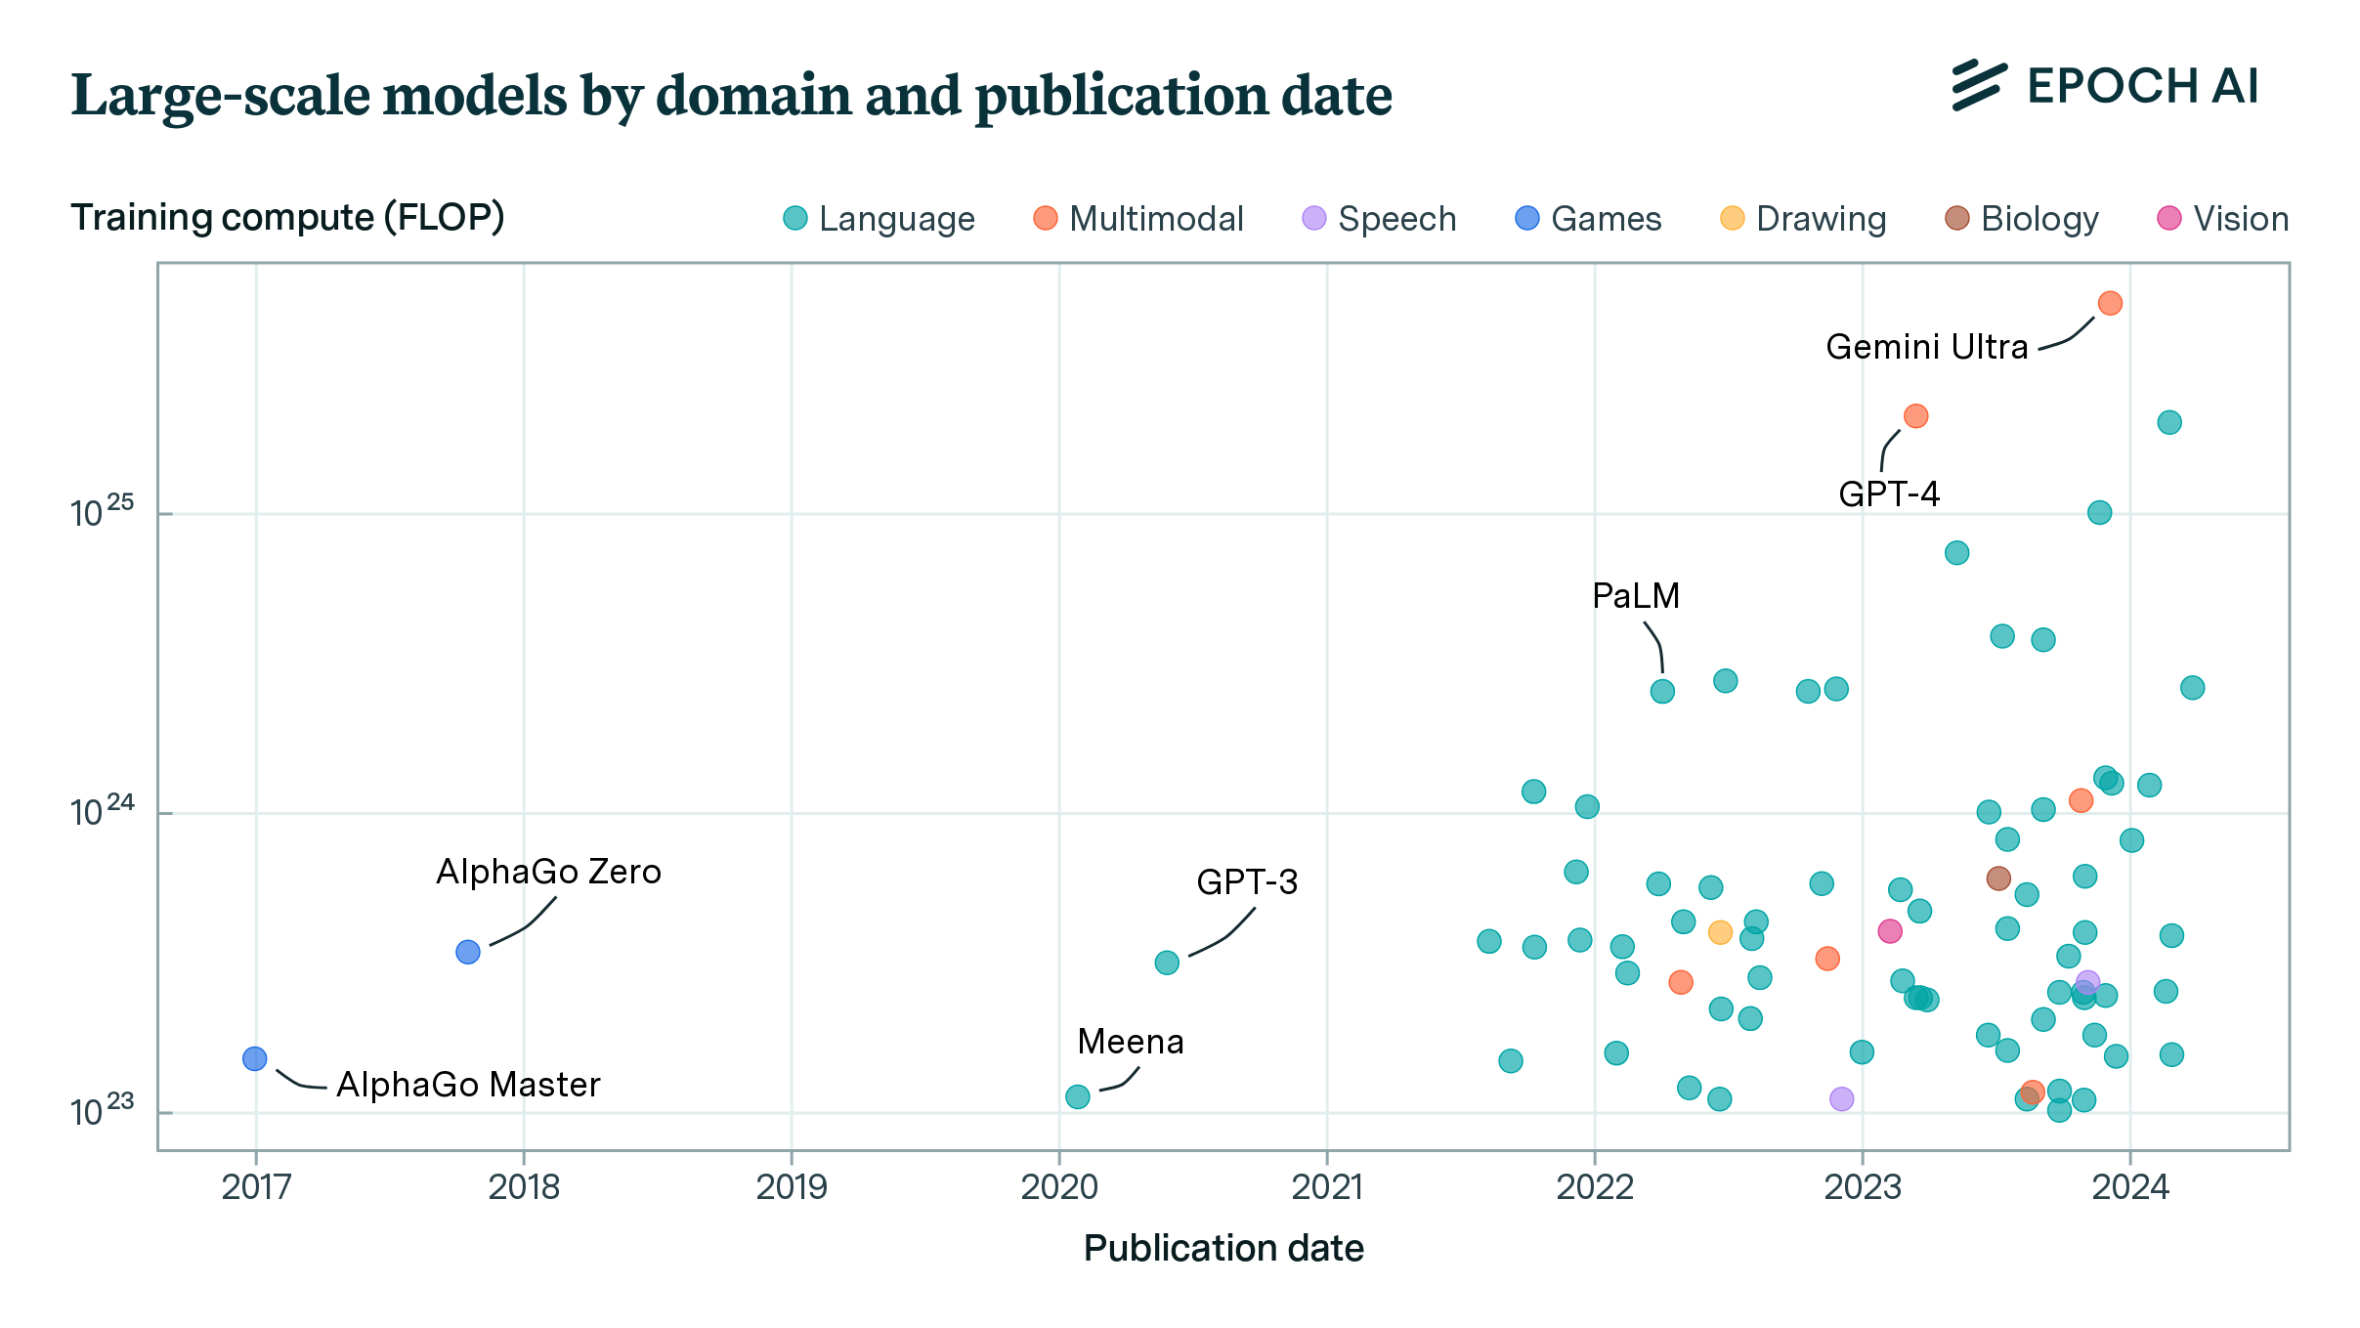
Model overview

Slide 9
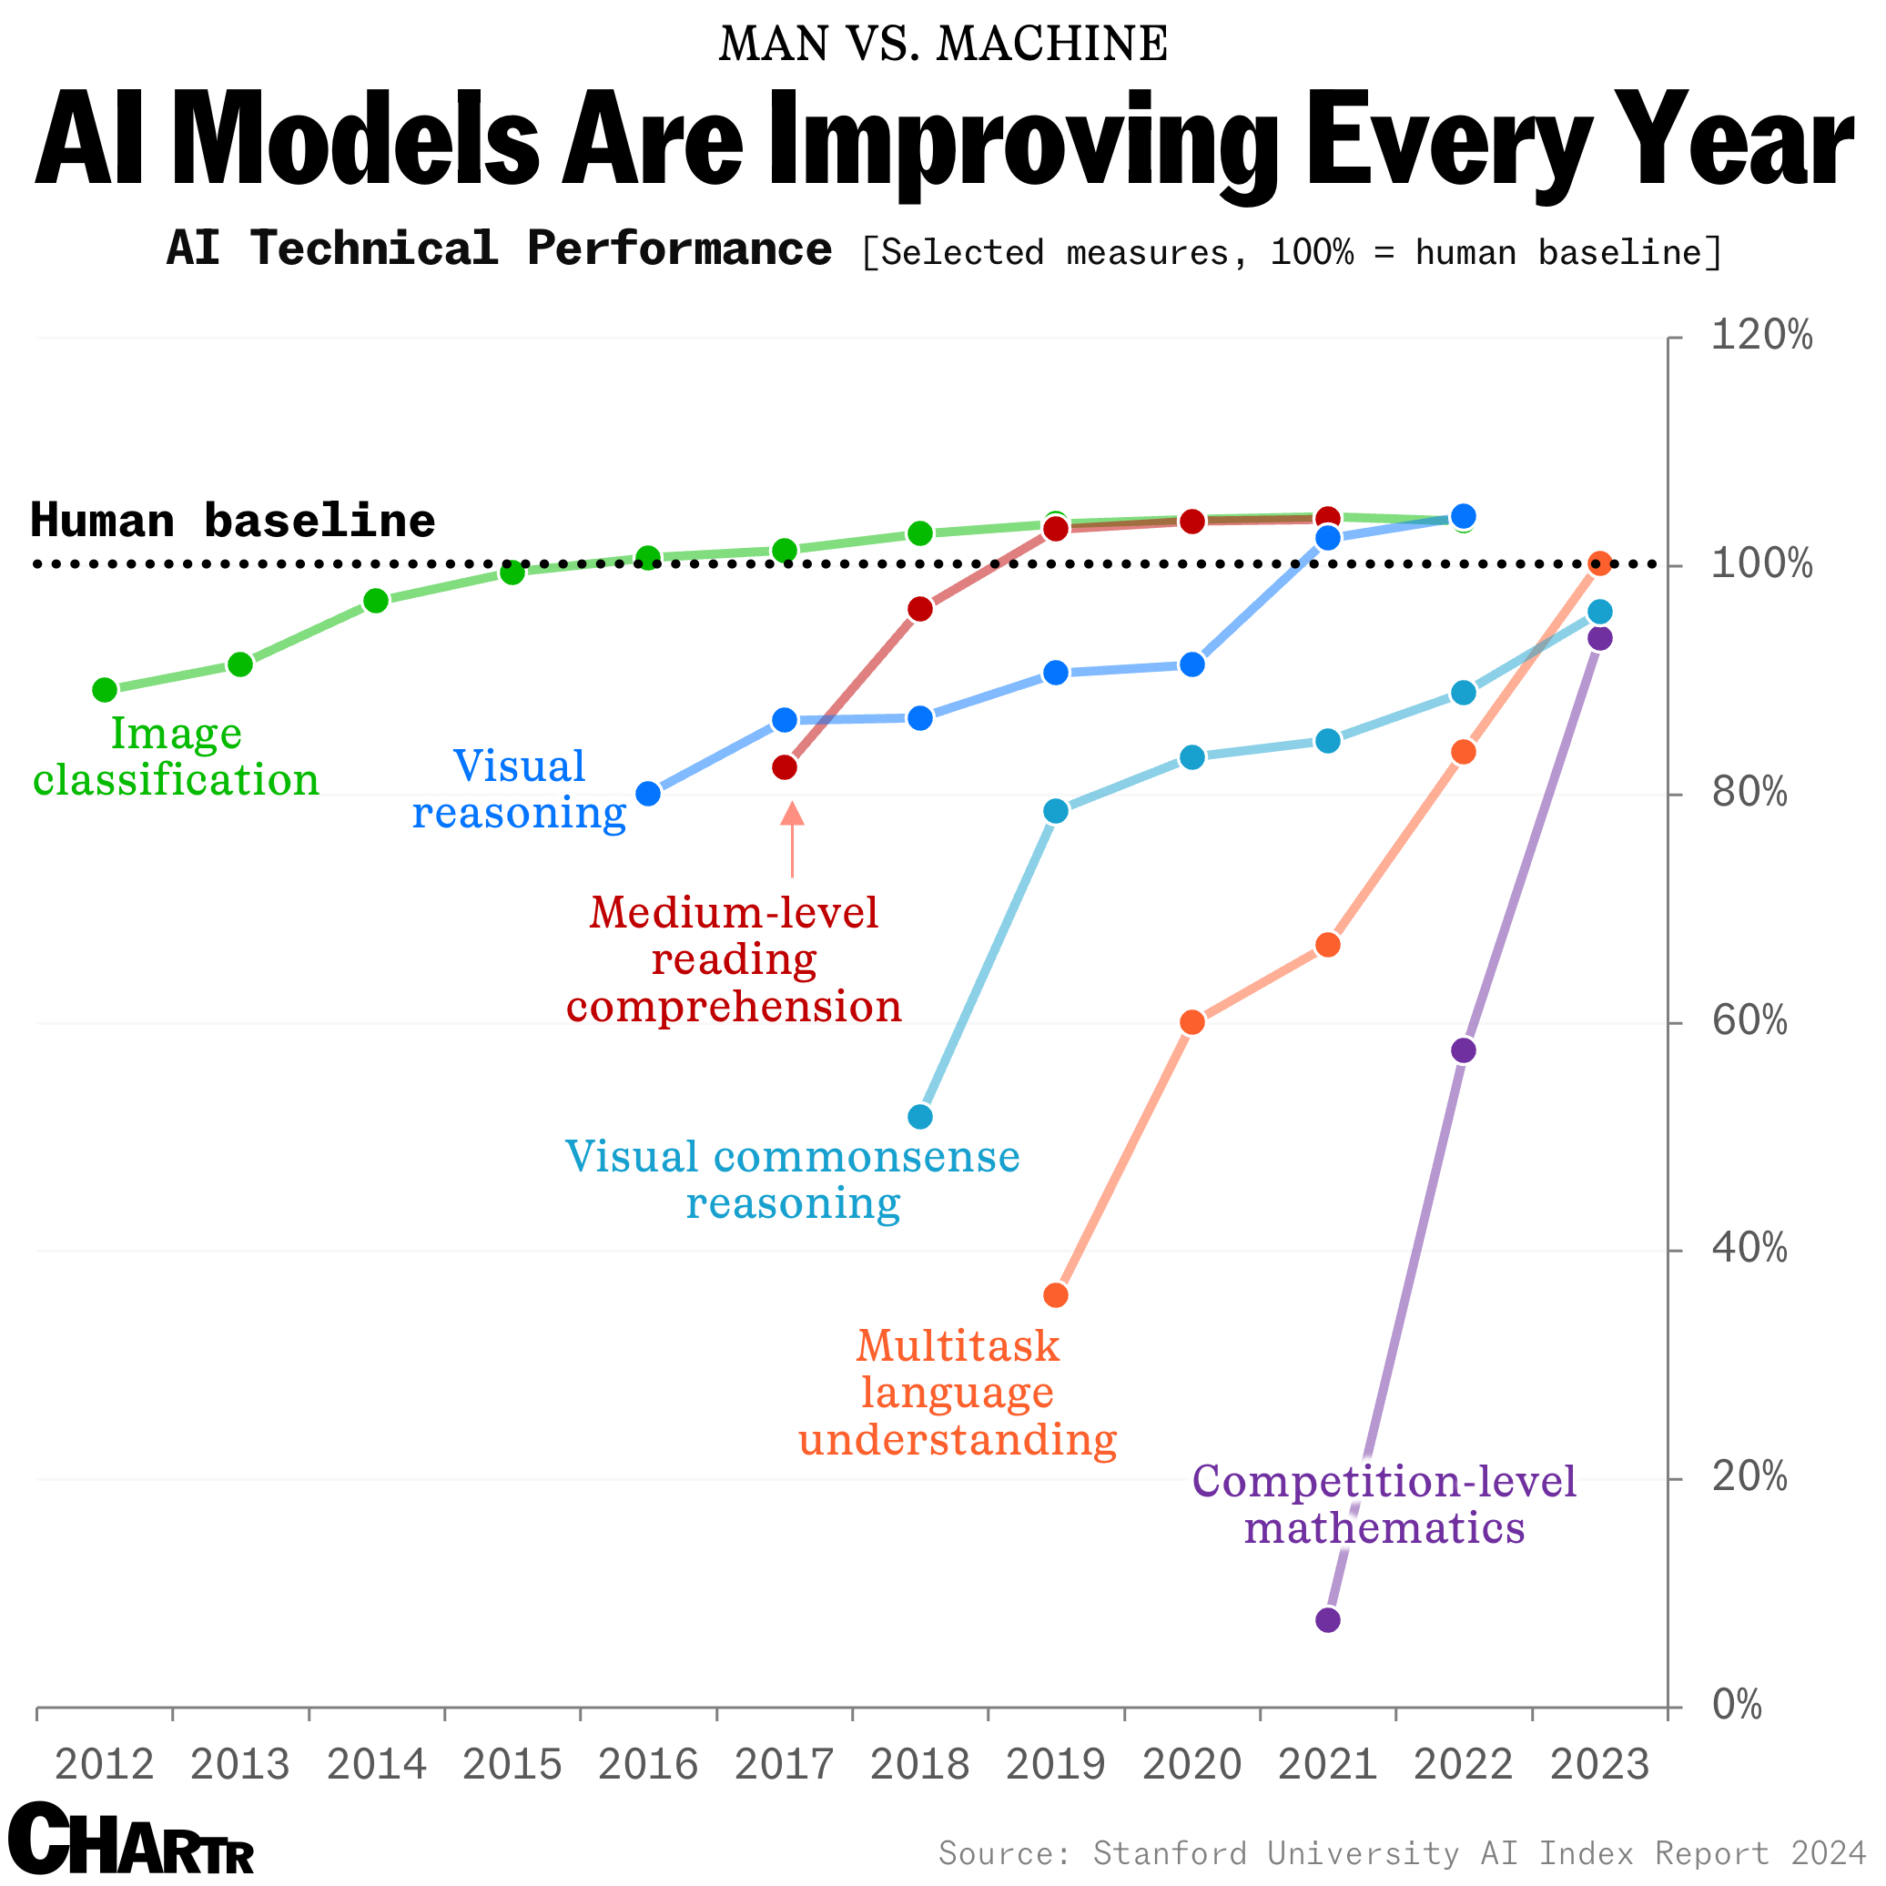
Towards AGI?
https://sherwood.news/tech/how-do-ai-models-stack-up-vs-humans-on-standardized-benchmarks/

Slide 10
The AI 5; directing future developments
Level 1; Conversational AI*
Level 2; Reasoning AI*
Level 3; Autonomous AI Agents
Level 4; AI Innovators
Level 5; AI Organizations
*Currently reached
https://www.linkedin.com/pulse/exploring-5-levels-ai-potential-implementations-each-level-colangelo-btkkf/

Slide 11
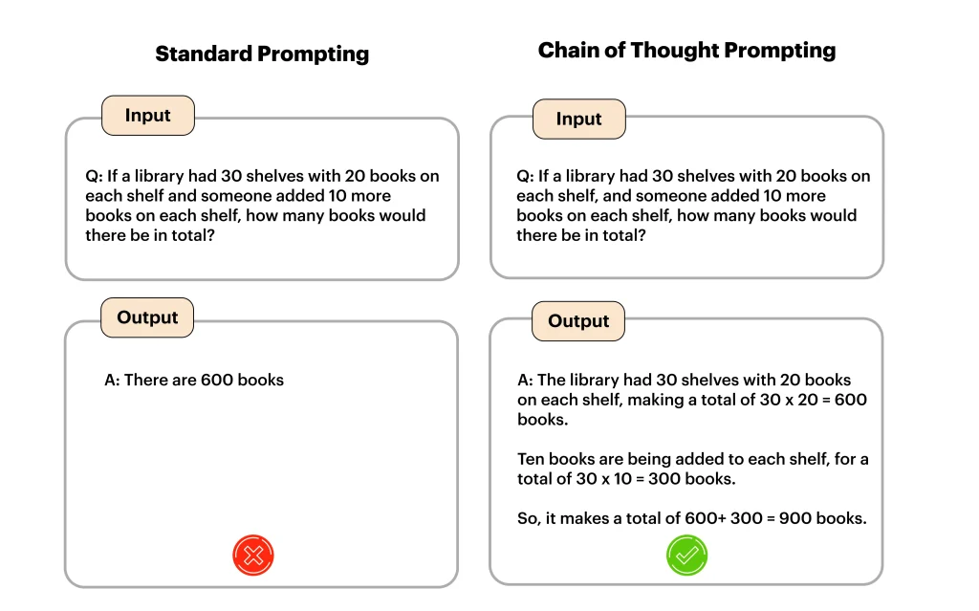
Chain-of-thought models (Level 2)
https://www.openxcell.com/blog/chain-of-thought-prompting/
Notes:
In standard prompting, the AI directly answers the question by considering its keyword patterns. This results in a false response or an oversimplification of a simple question.
On the other hand, the chain-of-thought prompt method structures the question into a simple step-by-step prompt. Then, it processes every component in a given order, resulting in a more accurate and reliable response.

Slide 12
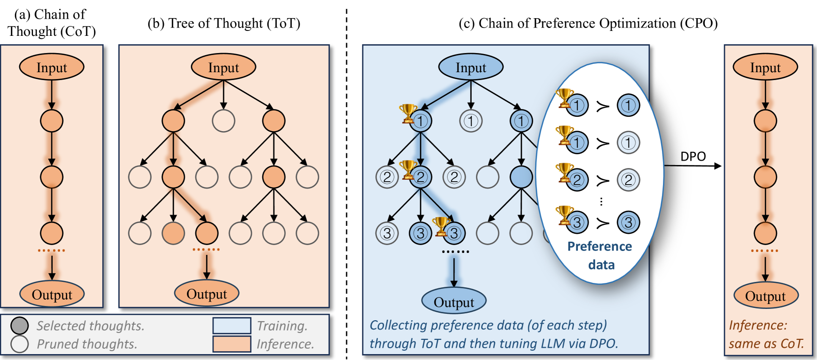
Improving chain of thought
https://arxiv.org/html/2406.09136v1
Notes:
Figure 1: Comparison of CoT, ToT, and CPO methods, where each node illustrates a step in the reasoning process, forming coherent language sequences aimed at solving a problem. The highlighted path indicates the chosen reasoning trajectory. In the CoT method, the LLM generates only one new node at each step, and all generated nodes are used to build the final reasoning path. For ToT, the LLM produces k new nodes at each step, but only the top n-best nodes are kept, with the rest being pruned. In CPO, nodes marked with a trophy represent preferred thoughts, while those marked with numbers are nodes that can be utilized to create preference data. This method uses the search tree structure from ToT to develop paired preference data, subsequently training LLMs to align with these preferences through DPO.

Slide 13
Applications of Chain of thought
Arithmetic Reasoning
Commonsense Reasoning
Symbolic Reasoning
Question Answering
Notes:
1. Arithmetic Reasoning
Solving real-world math problems poses a considerable challenge for large language models. By leveraging the chain of thought prompting with a 540B parameter language model, the model offers next-level performance on two popular benchmarks: MultiArith and GSM8K.
Here, CoT prompting enables the model to tackle multi-step math problems efficiently by breaking complex problems into smaller manageable steps. Also, CoT maintains the calculations easily by not skipping or making assumptions.
In general, the large language models are highly benefited through this approach, thus enhancing the accuracy and efficiency of arithmetic reasoning. Ultimately, the application represents the CoT’s ability to resolve complex problems with utmost accuracy.
2. Commonsense Reasoning
CoT prompting can do wonders in commonsense reasoning. Here, large language models break down hypothetical or situational scenarios, and then they understand and interpret the physical and human interactions, considering general knowledge.
Commonsense reasoning is applicable in various tasks, such as CommonsenseQA, StrategyQA, date understanding, and sports understanding. The performance of these tasks is directly proportional to the model size, which means it improves with an increase in model size.
Here, CoT breaks down the model’s thought process by throwing the right set of prompts, and improves accuracy, particularly in the case of understanding context and inferring conclusions such as sports understanding.
3. Symbolic Reasoning
Symbolic reasoning is a cognitive process involving various symbols and character strings representing multiple concepts, objects, and relationships. The method further involves manipulating these symbols and leveraging logical rules to reach a conclusion.
Symbolic reasoning is difficult to achieve in LLMs that leverage standard prompting, as they can’t capture the complexities of symbolic tasks. With chain-of-thought prompting, the model can implement step-by-step logic and handle various puzzles, algebraic problems, or logic games with precision.
Here, CoT is useful to enhance performance in various tasks that involve evaluation, such as last-letter concatenation in a word and coin flip.
This application showcases the CoT’s ability to remove all the limitations of symbolic reasoning, thus ensuring that AI becomes adaptable in different fields that involve strict logical consistency.
4. Question Answering
CoT prompting enhances the question-answering process by breaking down complex questions into smaller, digestible steps. This allows the model to interpret the question’s framework and the relationship between the components. Every component emphasizes a particular part of the question, which further allows the model to detect relevant information effortlessly.
The chain of thought prompt is also responsible for multi-hop reasoning. Here, the model constantly collects and combines information from numerous sources and documents on the web. This further enhances the inference and produces more precise and nuanced answers that cover all the angles.
Apart from this, CoT prompts force the model to specify the reasoning steps, which helps prevent basic errors and biases in the responses. Also, CoT gives a detailed explanation of how the LLM reached a particular conclusion.

Slide 14
Agent-based AI
Definition:
“Agent-based AI refers to a branch of artificial intelligence that focuses on creating autonomous entities known as agents. These agents can perceive their environment, make decisions based on that perception, and perform actions to achieve specific objectives. Essentially, each agent is an independent unit capable of intelligent behavior.”

Slide 15
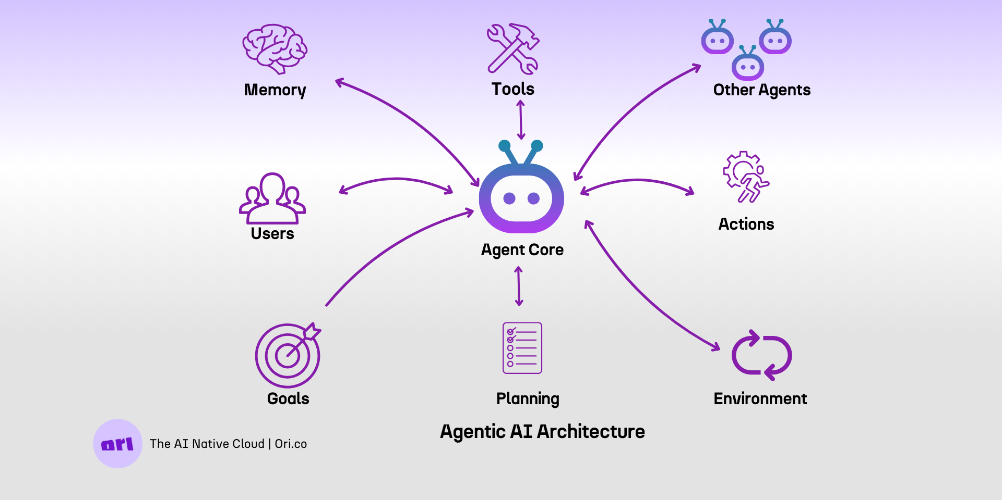
AI Agents visually represented

Slide 16


Future of AI in risk assessment
ToxPilot; an agentic
AI descision support
system to aid chemical
risk assessment
Tools in ONTOX and other projects
{
traceable stream
of reasoning;
data used is
transparent,
tracable &
outcome is explainable
}
information
requirement
access to information
[
tools provided by the
toxicology community
]

Slide 17
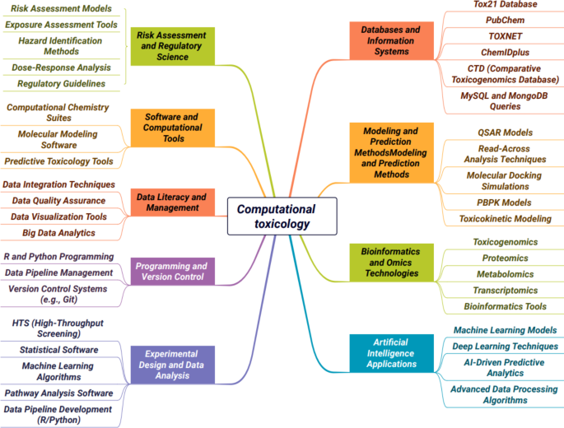
Many computational tools for toxicology

Slide 18
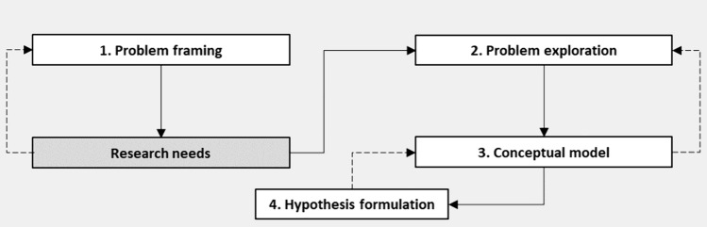
From equipping agents with problem formulation frameworks...
Achar J, Cronin MTD, Firman JW, Öberg G. A problem formulation framework for the application of in silico toxicology methods in chemical risk assessment. Arch Toxicol. 2024 Jun;98(6):1727-1740. doi: 10.1007/s00204-024-03721-6. Epub 2024 Mar 30. PMID: 38555325; PMCID: PMC11106140.

Slide 19
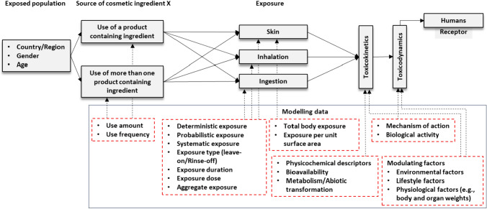
…To a risk assessment model
Achar J, Cronin MTD, Firman JW, Öberg G. A problem formulation framework for the application of in silico toxicology methods in chemical risk assessment. Arch Toxicol. 2024 Jun;98(6):1727-1740. doi: 10.1007/s00204-024-03721-6. Epub 2024 Mar 30. PMID: 38555325; PMCID: PMC11106140.

Slide 20





How to implement?
LLM
requirements
PERCEPTION,
COGNITION,
ACTION
agent(s)
tools:
pubmed_query(), rag(),
translate(), extract_data_from_graph(),
extract_data_from_table(),
named_entitity_recognition(),
add_to_db(), generate_hypothesis(), run_exposure_simulation(),
run_qsar(), run_qivive(), run_pbpk(), web_interact()
… [many, many more]

Slide 21
Tools
# Boolean search tool
def construct_boolean_query(query: str) -> str:
"""
Convert a natural language query into a PubMed boolean search query with partial matching
"""
llm = ChatOpenAI(model="gpt-4o", temperature=0)
boolean_prompt = PromptTemplate(
input_variables=["query"],
template="""Convert this natural language query into a proper PubMed boolean search query with partial matching:
Guidelines:
1. Use AND to combine terms that must all be present
2. Use OR to include alternative terms
3. Use NOT to exclude terms
4. Use parentheses () to group terms and operators
5. Use quotation marks "" for exact phrases
6. Use [Title/Abstract] to search in both title and abstract fields
7. Use wildcard * for partial matching
Query: {query}
Boolean search query:"""
)
boolean_chain = boolean_prompt | llm
result = boolean_chain.invoke({"query": query})
return str(result.content) if hasattr(result, 'content') else str(result)
Software written based
on executable functions,
that can perform a specific
task in a workflow
(autonomously or with a
human in-the-loop
approach) Can be shared and
published

Slide 22


Slide 23
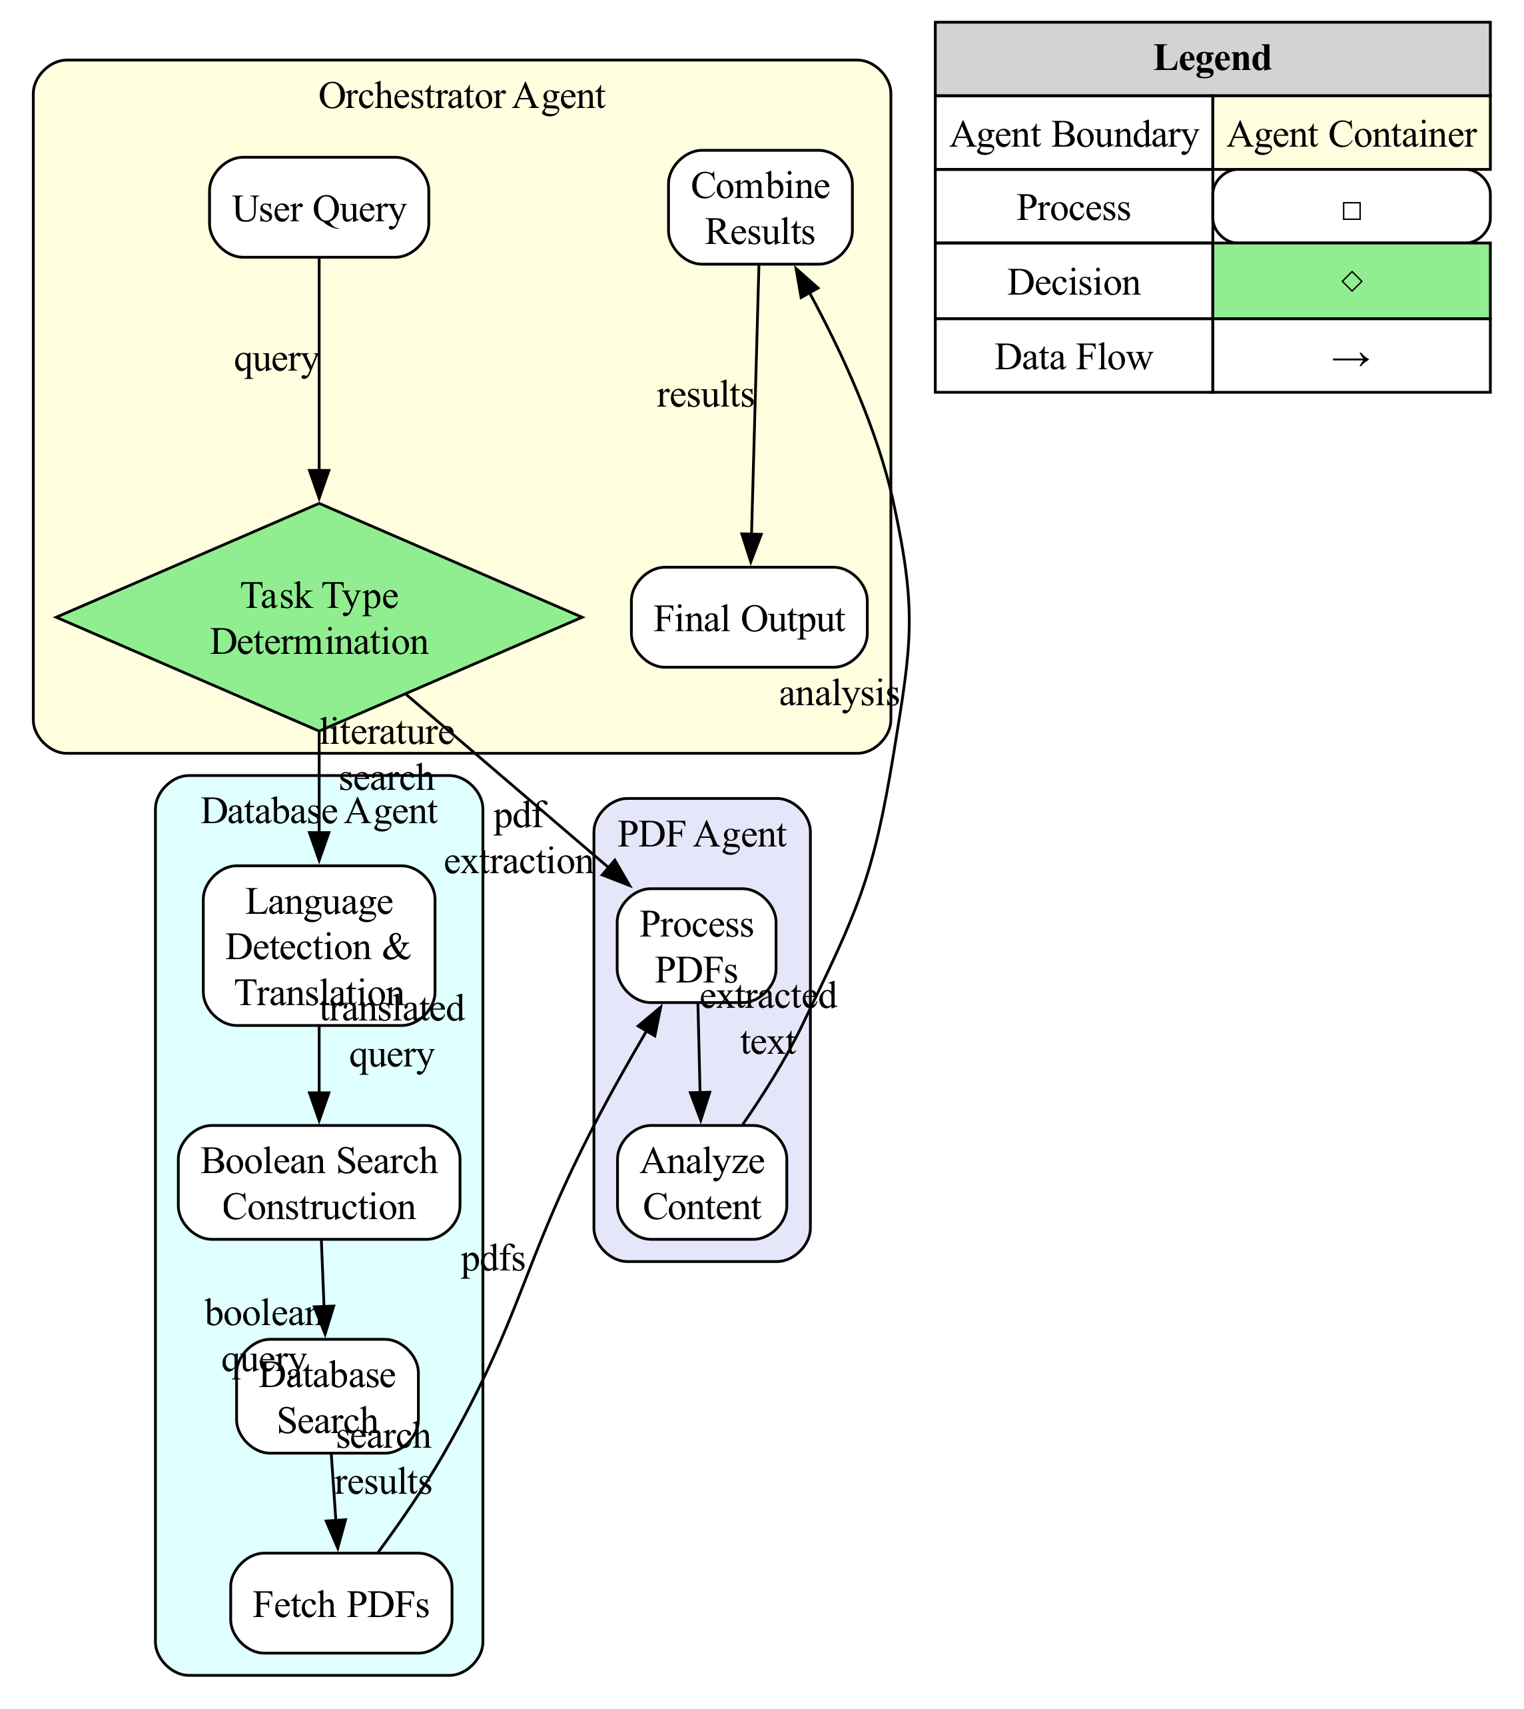

Multi-agent workflow for literature search and data extraction
https://langchain-ai.github.io/langgraph/

Slide 24
Demo

Slide 25
AI dilemmas

Slide 26
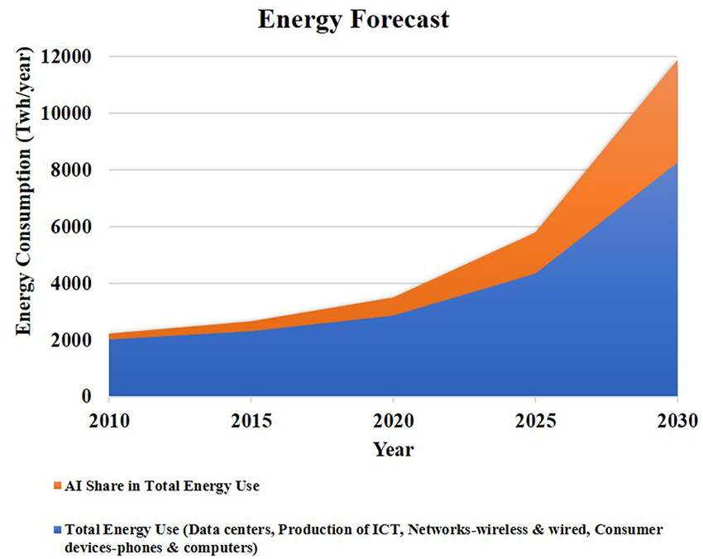
AI Energy consumption
http://dx.doi.org/10.3389/fnins.2019.00666

Slide 27
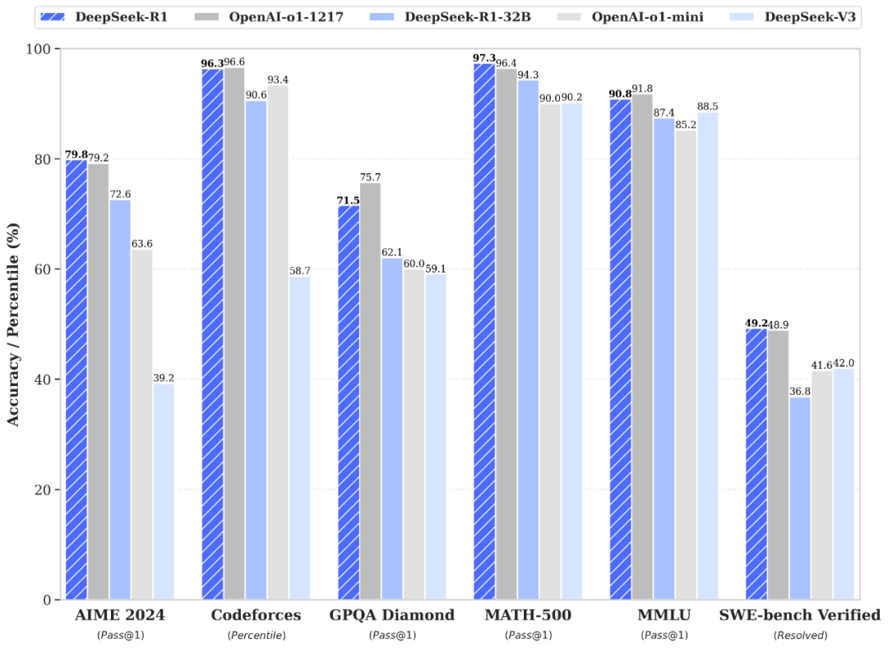
DeepSeek R1; a new model
DeepSeek R1 is about 95% ‘cheaper’ than
OpenAI o1. In terms of traning cost and is running at
at lower energy demand.

Slide 28

AI impacting the economy
20/01/2025, DeepSeek Release

Slide 29
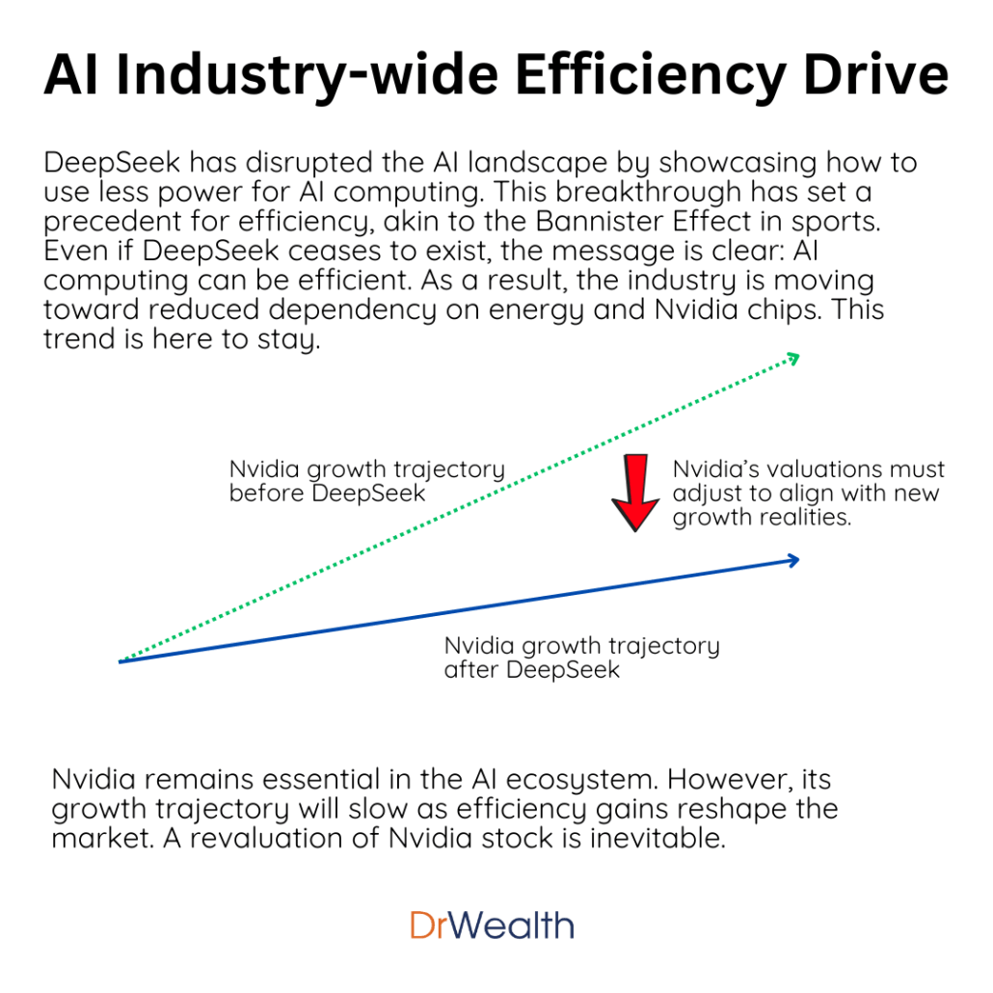
The search for reducing cost and energy consumption
Alternative architectures
Alternative hardware
Alternative algorithms

Slide 30
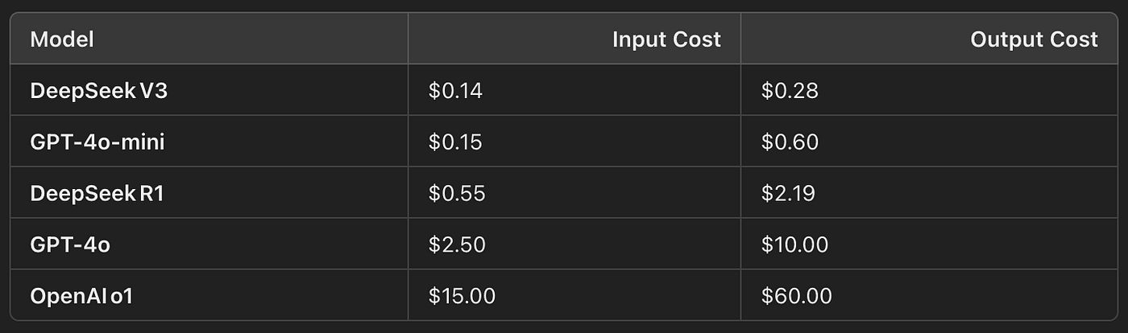
DeepSeek; Less energy & cheaper – but with sensorship
Why Is China criticized for human rights abuses with the Uyghurs?
What is Taiwan's status with China?
What happened at Tiananmen Square in 1989?
What are the biggest criticisms of Xi Jinping? and
How does censorship work in China?
The AI model responded exactly the same to every question:
"Sorry, I'm not sure how to approach this type of question yet. Let's chat about math, coding, and logic problems instead!"
https://medium.datadriveninvestor.com/the-chinese-obliterated-openai-a-side-by-side-comparison-of-deepseek-r1-vs-openai-o1-for-finance-93a1b4343a82
https://www.forbes.com/sites/maryroeloffs/2025/01/27/does-deepseek-censor-its-answers-we-asked-5-questions-on-sensitive-china-topics/

Slide 31
Open source vs. Closed source; advantages
1. Transparency: Full visibility into the models’ architecture and training data encourages trust and enables thorough evaluation.
2. Community Contributions: Contributions from a global community of developers can enhance the model’s capabilities and address issues like biases or bugs.
3. Customization: Users can tailor the model to specific needs, whether for niche applications or improved performance in particular contexts.
4. Cost: Open-source models are typically free to use, although there may be costs associated with computing resources and infrastructure.
1. Professional Support: Closed-source models often come with dedicated support teams, regular updates, and maintenance services.
2. Performance and Optimization: Companies behind closed-source models can leverage extensive resources to fine-tune performance and efficiency.
3. Ease of Use: Closed-source models typically offer user-friendly APIs and integration tools, streamlining implementation.
https://medium.com/@sangitapokhrel911/open-source-and-closed-source-llms-a-detailed-comparison-58d3107722e8

Slide 32
Open source vs. Closed source; challenges
1. Maintenance: Open-source models may lack the consistent support and updates provided by commercial entities, depending on community engagement.
2. Performance Variability: The quality of open-source models can vary, and advanced optimization may not always be available.
1. Cost: Licensing fees or subscription costs can be substantial, depending on usage and model capabilities.
2. Limited Transparency: Users have less insight into the model’s inner workings, which can impact trust and understanding.
3. Less Customization: Customizing closed-source models is generally limited compared to open-source alternatives.
https://medium.com/@sangitapokhrel911/open-source-and-closed-source-llms-a-detailed-comparison-58d3107722e8

Slide 33
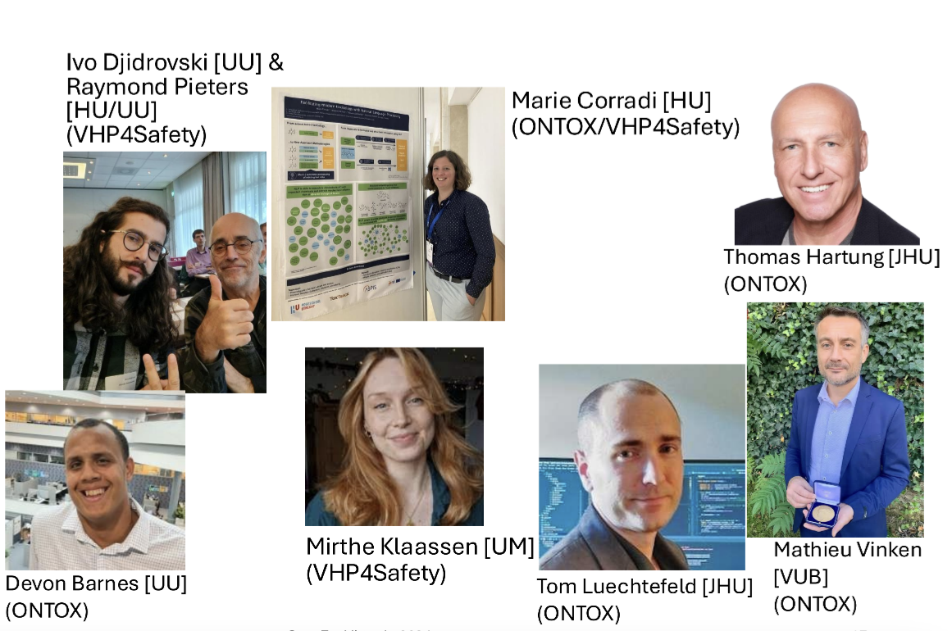
Team

